Slide 1

NINJA TURTLES
Project Name: HealthGo

Slide 2
PROBLEM STATEMENT
Every year millions of people Worldwide suffer stroke and a majority of these people either are permanently disabled, or they pass away. The treatment needs to be started at the earliest from the moment the patient experiences the first symptom of stroke, but because of lack of proper communication between organizations, there is a delay in the treatment

Slide 3
STATISTICS AND FIGURES
U.S. STATS
WORLDWIDE STATS
Stroke is the 3rd leading cause of death in the United States.
Each year, approximately 795,000 people suffer stroke and more than 140,000 people die of stroke.
According to W.H.O, 15 million people suffer stroke each year, of which 5 million die and 5 million are permanently disabled.
Source: http://www.strokecenter.org/patients/about-stroke/stroke-statistics/

Slide 4
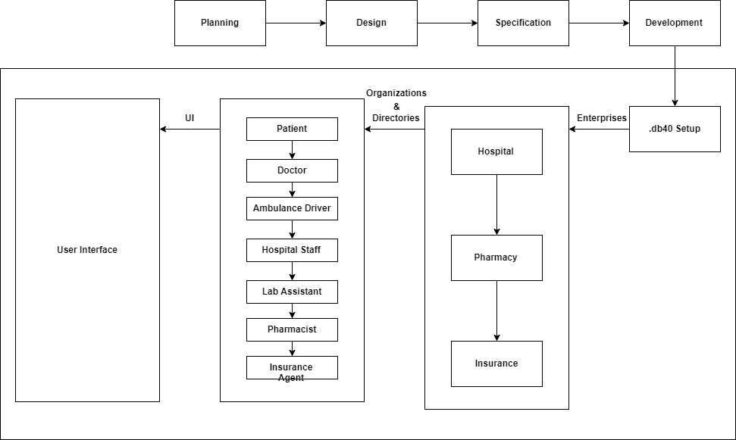
APPROACH

Slide 5
SOLUTION TO THE PROBLEM
When a person suffers stroke, he/she usually has 3.5 hours to get treated with the first hour being the most critical one. HealthGo is an application to help the patient get immediate treatment in time, by alerting the required help like doctors, hospitals and pharmacies. This will reduce the communication delay between organizations and thus reduce the overall door to needle time which will increase the chances of survival.

Slide 6
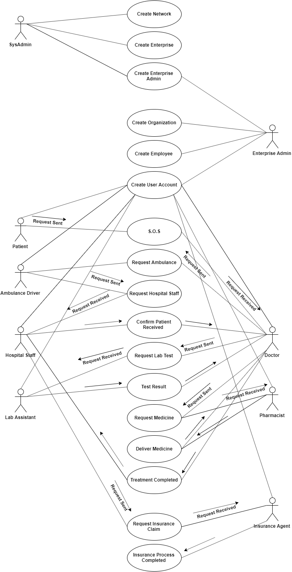
USE CASE

Slide 7
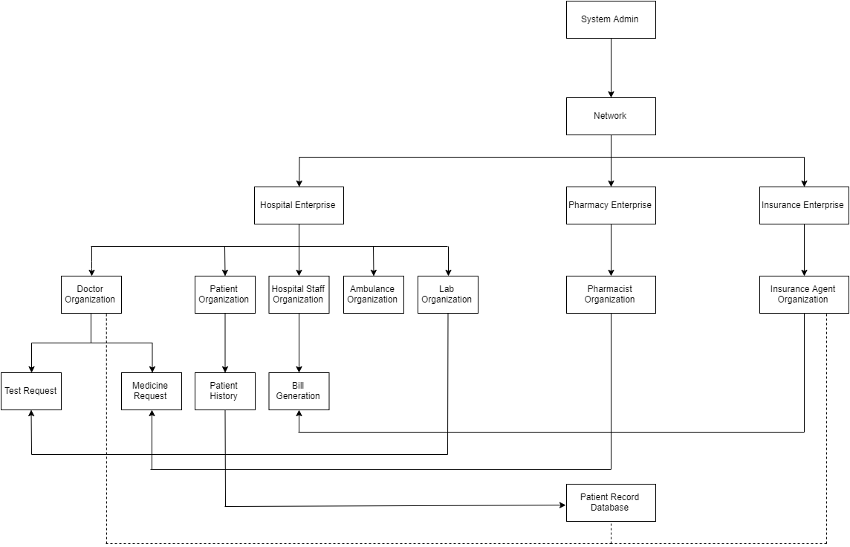
OBJECT MODEL DIAGRAM

Slide 8
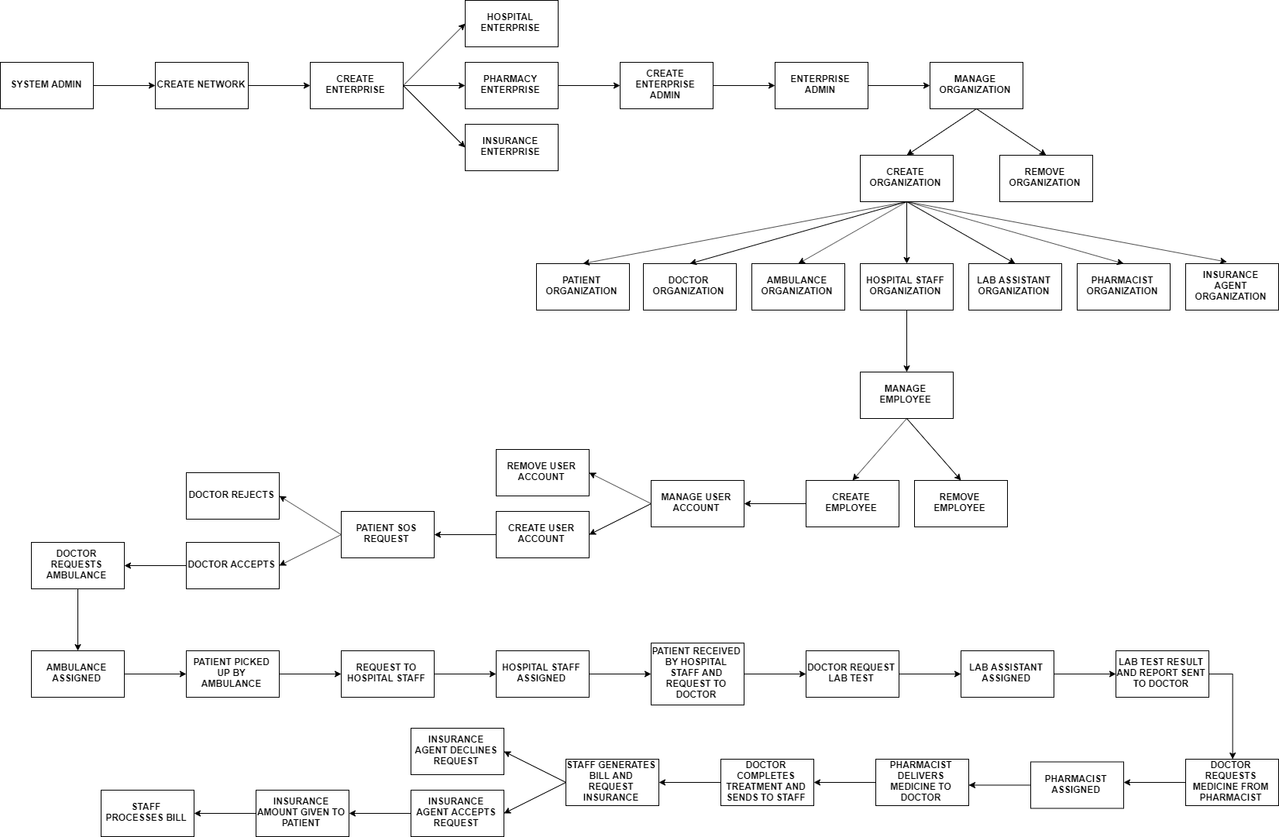
WORK FLOW

Slide 9
DEMONSTRATION

Slide 10
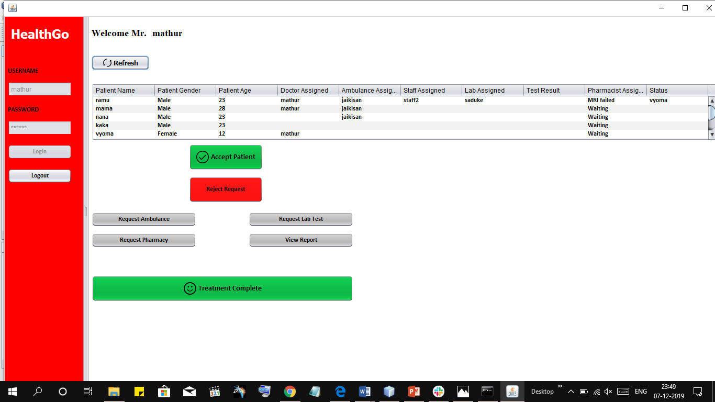

Slide 11
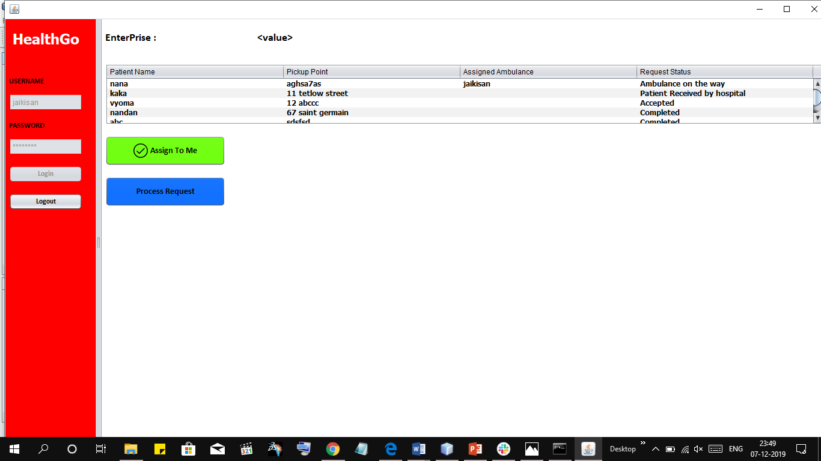

Slide 12
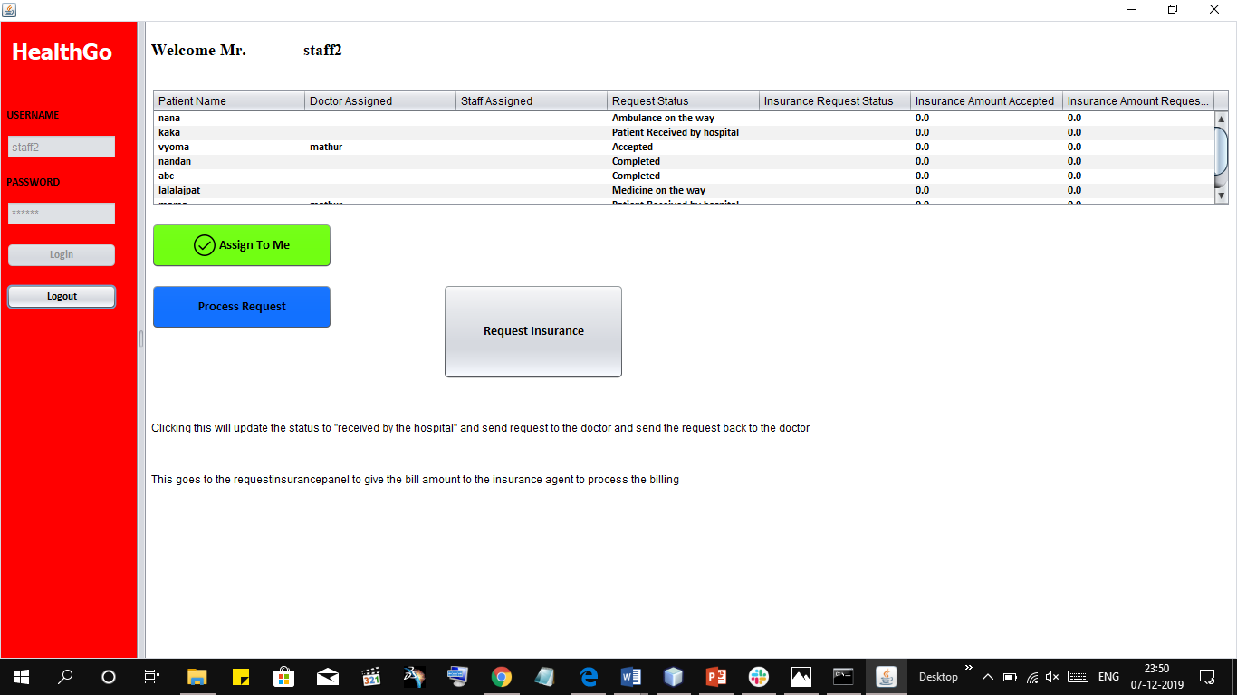

Slide 13
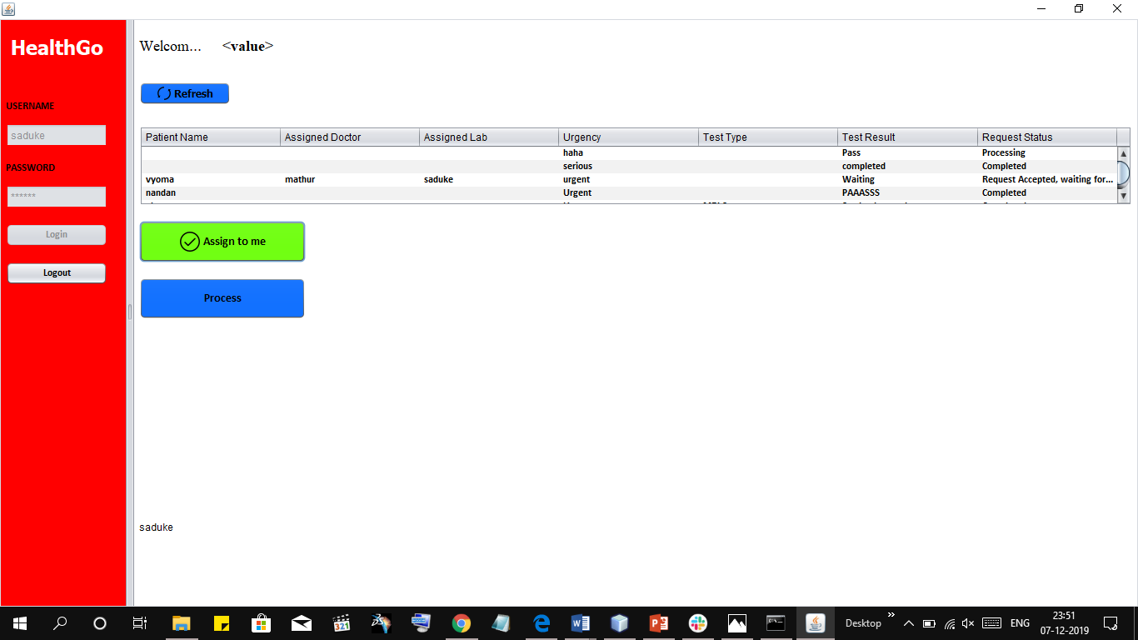

Slide 14
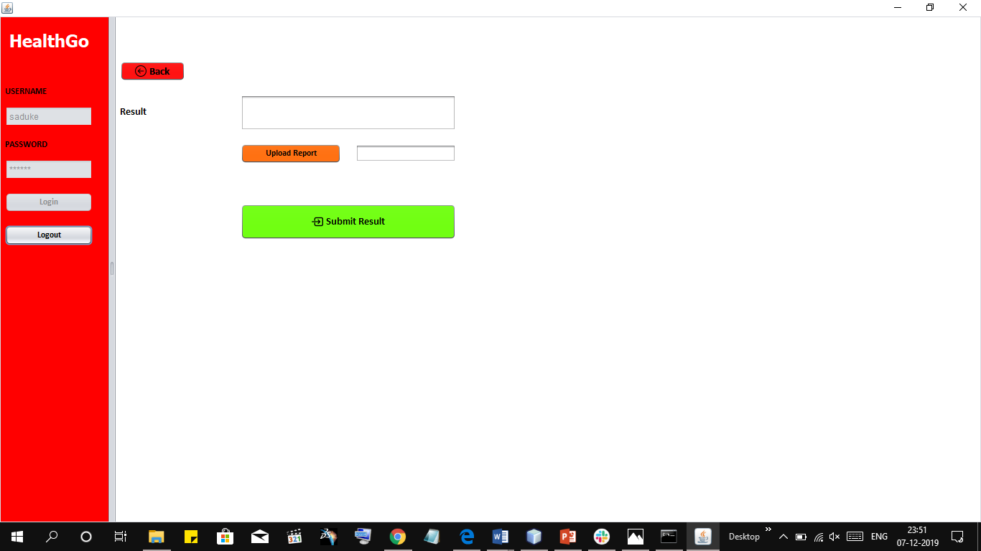

Slide 15
TEAM NINJA TURTLES
Team Members
Dhanur Motwani
motwani.d@husky.neu.edu
Atulya Sharma
sharma.at@husky.neu.edu

